Slide 1


DOLLY: A VOICE-ACTIVATED AND GESTURE-RECOGNIZING
SMART TRASHCAN UTILIZING THE YOLO ALGORITHM FOR
AUTONOMOUS NAVIGATION
BSCS 4-A
Arnold Rie J. Sejera, John Mark C. Ruam, , Gerald M. Carique

Slide 2
Managing waste is essential for creating sustainable and livable cities. However, certain people cannot segregate waste because they cannot move or walk. To address this problem the researchers cope with creating a prototype smart trashcan that can interact with a person with mobility impairments. Hand gestures and voice activation help them dispose of their trash without excessive force.
INTRODUCTION

Slide 3
REPORTS
According to a World Bank report, around the world waste management rates are rising. In 2020, the world was estimated to generate 2.24 billion tons of solid waste, amounting to a footprint of 0.79 kilograms per person per day. With fast-paced growth and urbanization, the annual waste generation rate is expected to increase by 73 percent from 2020 levels to 3.88 billion tonnes in 2050
2020
2030
2040
2050

Slide 4
CURRENT STUDIES
Recent research on waste management indicates that, despite initiatives to enhance trash segregation, recycling, and disposal, many persons encounter challenges that hinder their participation in these efforts.

Slide 5
PROBLEM
People with mobility impairments often encounter significant challenges in their daily lives, including waste management or trash disposal because of their physical barriers. This can make it difficult for individuals with mobility impairments to dispose of waste if the trash bins are not easily accessible. Transporting waste to disposal sites can be challenging especially if the sites are located at a distance. And through the years there is often a lack of assistance tools designed to help people with mobility impairments to handle waste. This can make the process of waste disposal more difficult and time-consuming.

Slide 6
GAP BRIDGE BY THE STUDY
The existing review of literature and studies highlights a significant gap in research related to smart trashcans. Specifically, no studies explore the intersection of voice-activated smart trashcans requiring unique names for activation and location tracking of individuals. Additionally, no research has been conducted on autonomous smart trashcans equipped with object-detection capabilities to locate waste-disposing individuals. This gap presents an opportunity for innovative solutions in waste management technology.

Slide 7
OBJECTIVES
SPECIFIC OBJECTIVES
To train and evaluate the YOLO algorithm for autonomous navigation of the trashcan.
To integrate a trained autonomous smart trashcan model with hand gesture recognition into a prototype.
To test the effectiveness of the prototype Dolly autonomous trashcan
GENERAL OBJECTIVE
The main goal of this study is to develop a prototype of a smart trashcan robot that will utilize the YOLO algorithm to identify thumbs-up gestures for autonomous navigation.

Slide 8
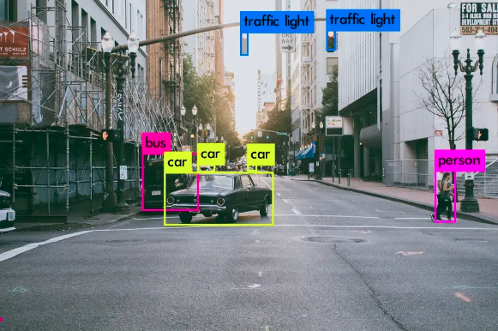
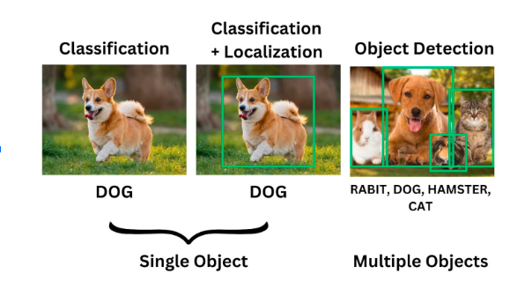
METHODOLOGY
Theorems, Algorithm, and Mathematical Model
The researchers came up with the utilization of the YOLO algorithm. The concept of object detection is utilized to identify the location of the target. The algorithm is suitable since several studies claimed that YOLO outperformed the most common CNN regarding object detection. In a more precise understanding of the algorithm, The input image is divided into S x S grids. If the central point of an object is located within a grid cell, then that grid cell is Tasked with identifying the occurrence of that object. B Bounding boxes and confidence scores are also predicted in each cell. Confidence score is the accuracy of predicting whether the box contains an object. It is defined as Pr(Object) * IoU truth over prediction.

Slide 9
Materials and Statistical Tools
METHODOLOGY
Hardware Tools
Software Tools
Raspberry pi 4 model B
Battery/Power Bank
Jumper Wires
Wireless earphone
mg995 servo motors
robot chassis
LED
Arduino Uno
USB Web camera
5v to 12v DC cable
trashcan
Python
Ultralytics
Yolo algorithm
Visual Studio Code
Arduino IDE
Google Colab

Slide 10
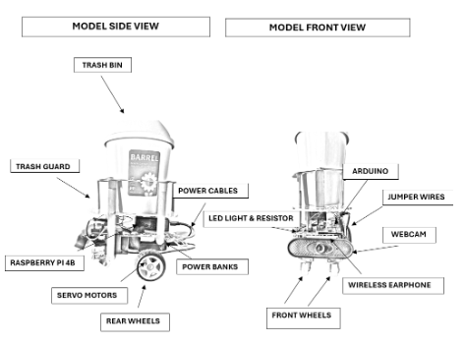
PROTOTYPE MOCK-UP DESIGN

Slide 11
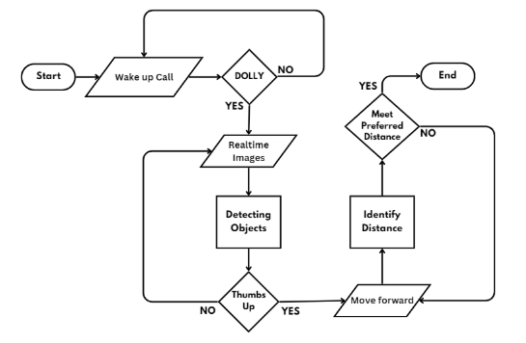
MODEL FLOWCHART

Slide 12
METHODOLOGY
Theoretical Framework
This project aims to create DOLLY, a smart trashcan that can travel independently using voice activation and gesture detection. The YOLO (You Only Look Once) object detection algorithm is used in the project to combine voice-activated technology, gesture-based interface, and autonomous navigation. Human-Computer Interaction (HCI), Gesture Recognition Theory, and Autonomous Robotic Navigation are the three primary fields that define this framework.

Slide 13
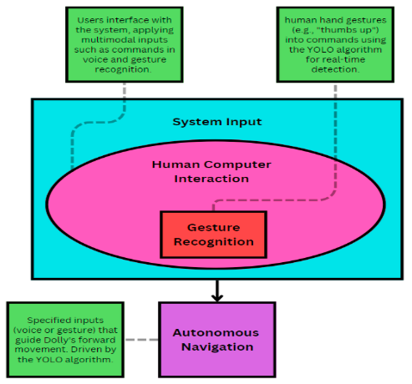
METHODOLOGY
Theoretical Framework

Slide 14
DATA PREPERATION
Researchers gathered .jpg images as data for object detection; pictures were taken using a Tecno Camon 20 Pro 5G Android phone camera. Different lighting conditions, distances, and perspectives were employed to mimic realistic settings. The researchers gathered photos in an office setting for improved backdrop visualization of the model in its detection process to recognize the item, even though with some background noise like to strengthen the model's resilience in various settings, added by some images online. Researchers acquire enough data to train the model. The dataset comprises 1699 photos; the team utilized Roboflow to annotate collected images and build the dataset. Furthermore, each picture was manually labeled using Roboflow's annotation tool to construct bounding boxes around gestures. The labels were specified as either thumbs up or thumbs down, creating the foundation of the object detection model.

Slide 15
DATA PREPERATION
Data Preprocessing and Augmentation
Researchers employed cropping and noise augmentation methods in the Roboflow, as well as Auto-Orient, Auto-Adjust Contrast utilizing Histogram Equalization, and Resize to expand the picture size to 640 x 640 preprocessing approaches to boost the model's generalization.
The group used Roboflow augmentations to gather 4073 pictures into a dataset; 347 were valid datasets, 3561 were train datasets, and 165 were test datasets.

Slide 16
MODEL PERFORMANCE METRICS
The performance of the created YOLOv8 model was evaluated using several critical criteria to ascertain how effectively it recognized gestures.
The Mean Average Precision (mAP), tested at 95%, indicated the model's overall accuracy in correctly classifying both "thumbs up" and "thumbs down" gestures across several test scenarios.

Slide 17
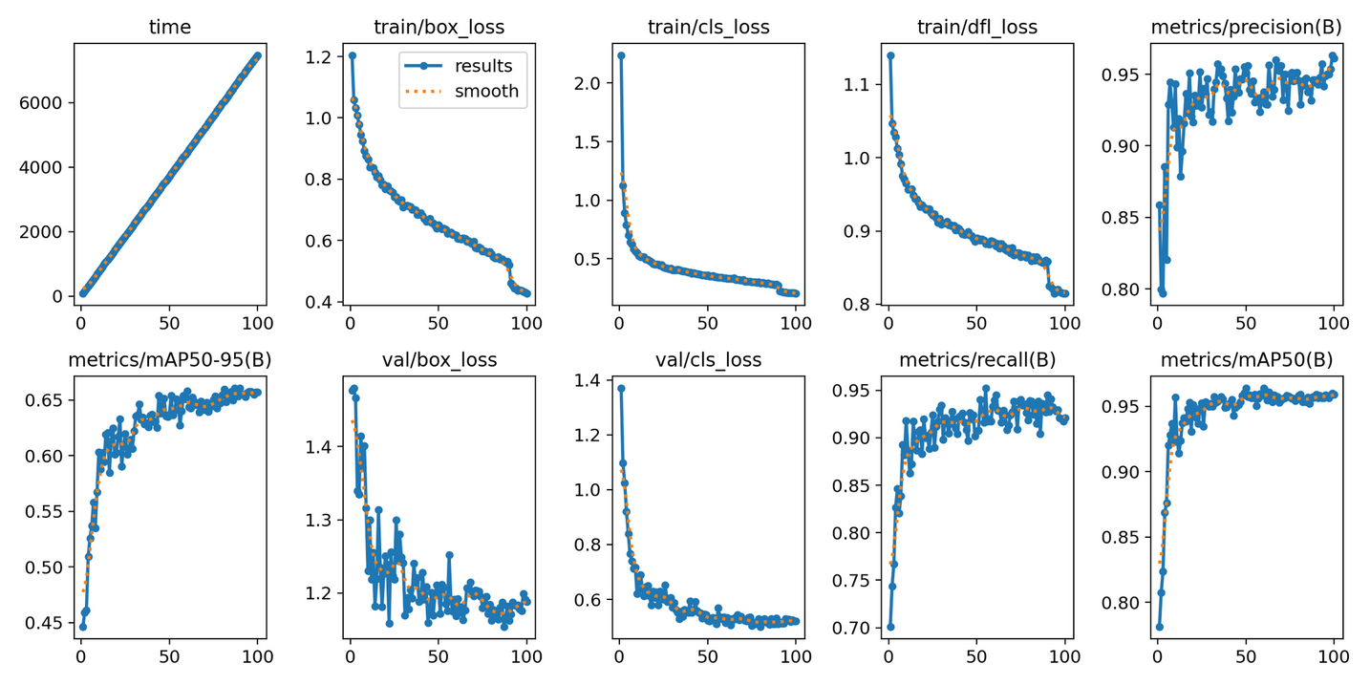
MODEL PERFORMANCE METRICS

Slide 18
PROTOTYPE DEVELOPMENT
Results
The project effectively combined speech and gesture recognition with decent movement control into a single system. The fundamental problems were improving the YOLO model for real-time performance and maintaining reliable communication between the Raspberry Pi and Arduino. Despite these hurdles, Dolly achieved its goal of creating a hands-free, interactive garbage disposal solution.

Slide 19
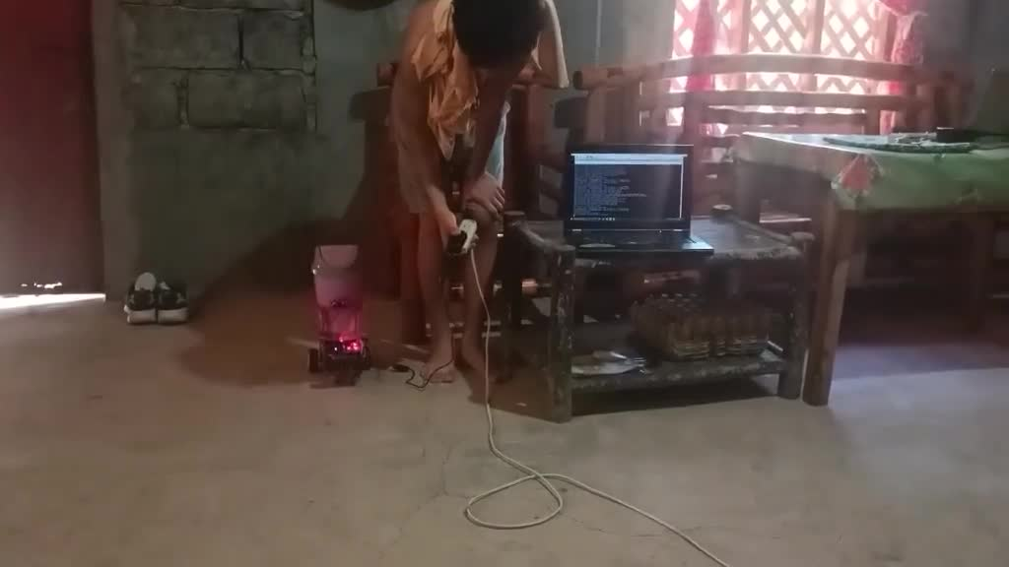
TEST CASE

Slide 20
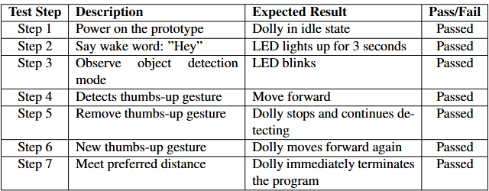
TEST CASE

Slide 21
SUMMARY OF FINDINGS
Model Training and Evaluation
The YOLOv8 model was trained on a custom-augmented dataset of 1,699 images, achieving a mean average precision (mAP) of 95%, with 94% recall and accuracy.
The model reliably detected "thumbs up" and "thumbs down" gestures in varied lighting conditions and perspectives.

Slide 22
SUMMARY OF FINDINGS
Prototype Development and Model Integration
Integrating the YOLOv8 model with Dolly's hardware (Raspberry Pi 4, USB webcam, MG995 servo motors, and HC-SR04 ultrasonic sensor) enabled seamless gesture-based navigation and interaction.
Key functionalities included:
Reliable serial communication between the Raspberry Pi and Arduino ensured precise motion control and stable operation.
Wake word detection using pvporcupine.
Gesture recognition for "thumbs up" to navigate.
Obstacle detection via the ultrasonic sensor to prevent unintended forward movement.

Slide 23
SUMMARY OF FINDINGS
System Testing
Wake word recognition achieved 93% accuracy, robustly identifying "Hey Dolly" amidst diverse audio conditions.
The YOLOv8 model demonstrated 93% mAP50 for "thumbs up" gestures, maintaining accuracy across dynamic perspectives and lighting.
The ultrasonic sensor effectively stopped movement when objects were detected within 50 cm, ensuring safe interactions.
The system successfully fulfilled its seven expected outcomes, proving the prototype’s functionality, reliability, and potential for future innovation.

Slide 24
CONCLUSIONS
The smart trashcan prototype successfully met its objectives, with the YOLOv8 model achieving 95% mAP and 94% accuracy for real-time gesture recognition under varied conditions. Despite hardware limitations, it maintained an inference time of 600–800 ms per frame.
The integration of hardware (Raspberry Pi, USB camera, servo motors, ultrasonic sensor) and software (gesture and wake word detection) enabled reliable navigation, safe interactions, and intelligent responses. System testing confirmed its accuracy (93% mAP50 for gestures), safety, and adaptability, proving the prototype’s effectiveness and potential for future development.

Slide 25
RECOMMENDATIONS
Future improvements for Dolly should focus on optimizing wake word detection for noisy environments, enhancing model accuracy and efficiency through hyperparameter tuning or lightweight alternatives, upgrading hardware for faster inference, improving obstacle detection with additional sensors, expanding capabilities for advanced tasks like waste sorting, increasing energy efficiency, and adding return funtion to its starting position for continuous operation.

Slide 26
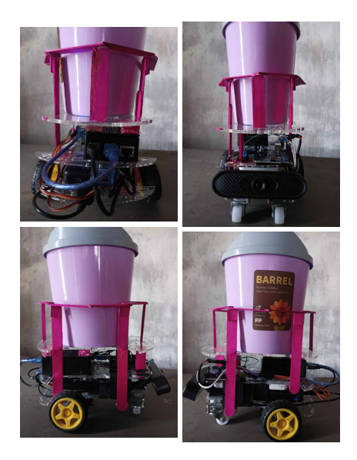
THANK YOU
BSCS 4-A
Arnold Rie J. Sejera
John Mark C. Ruam
Gerald M. Carique

